Slide 1
Benford analysis on aviation statistics
Tell me the fishy data!

Slide 2
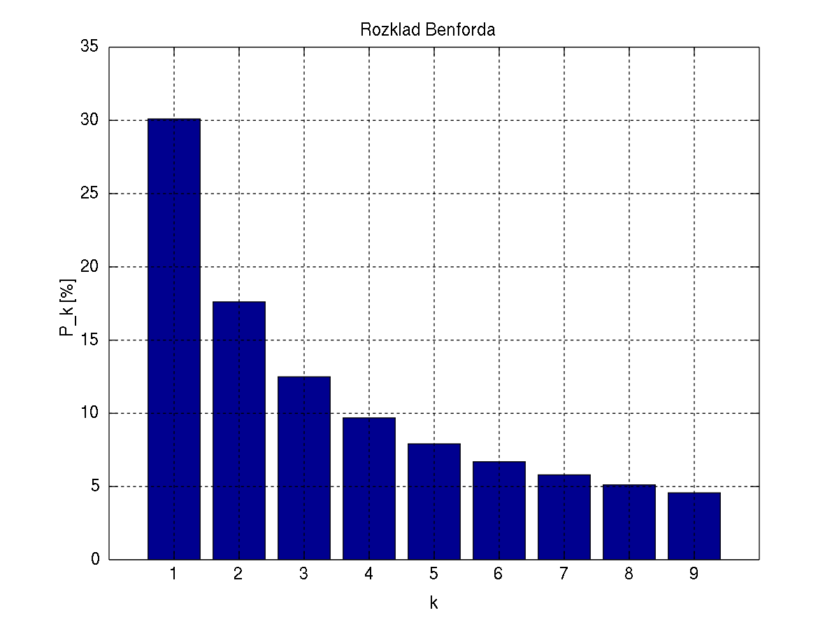
What is Benford's law?
1. Benford's law is a phenomenological law also called the first digit law.
2. Digit 1 tends to occur with probability of 30%, greater than the expected of 11%

Slide 3
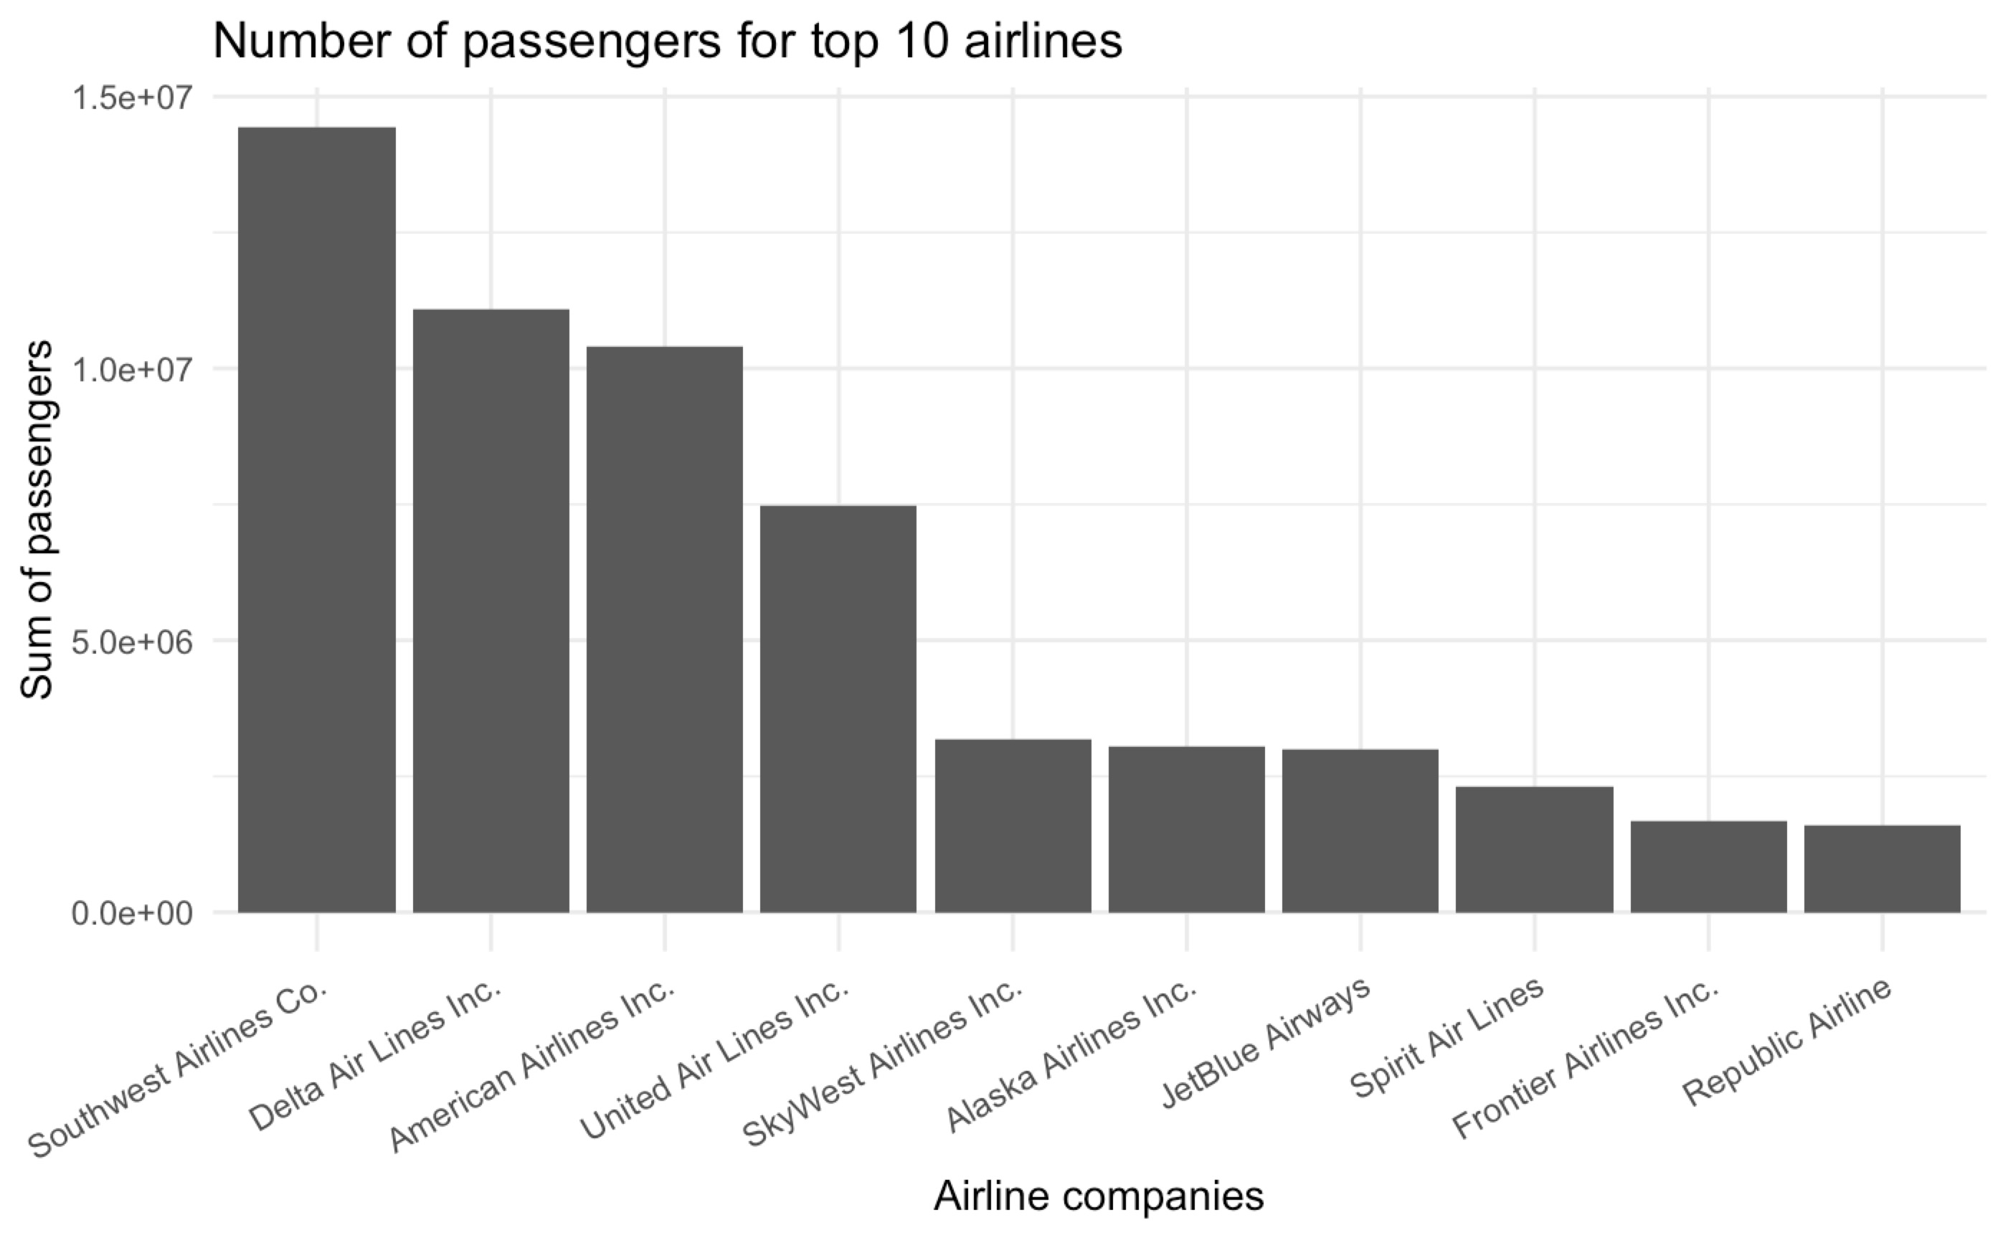
What is the distribution of top 10 airlines?
We can see that out of top 10 airlines, top 3 airline companies have numbers begin with 1. Is this a coincidence or not?

Slide 4
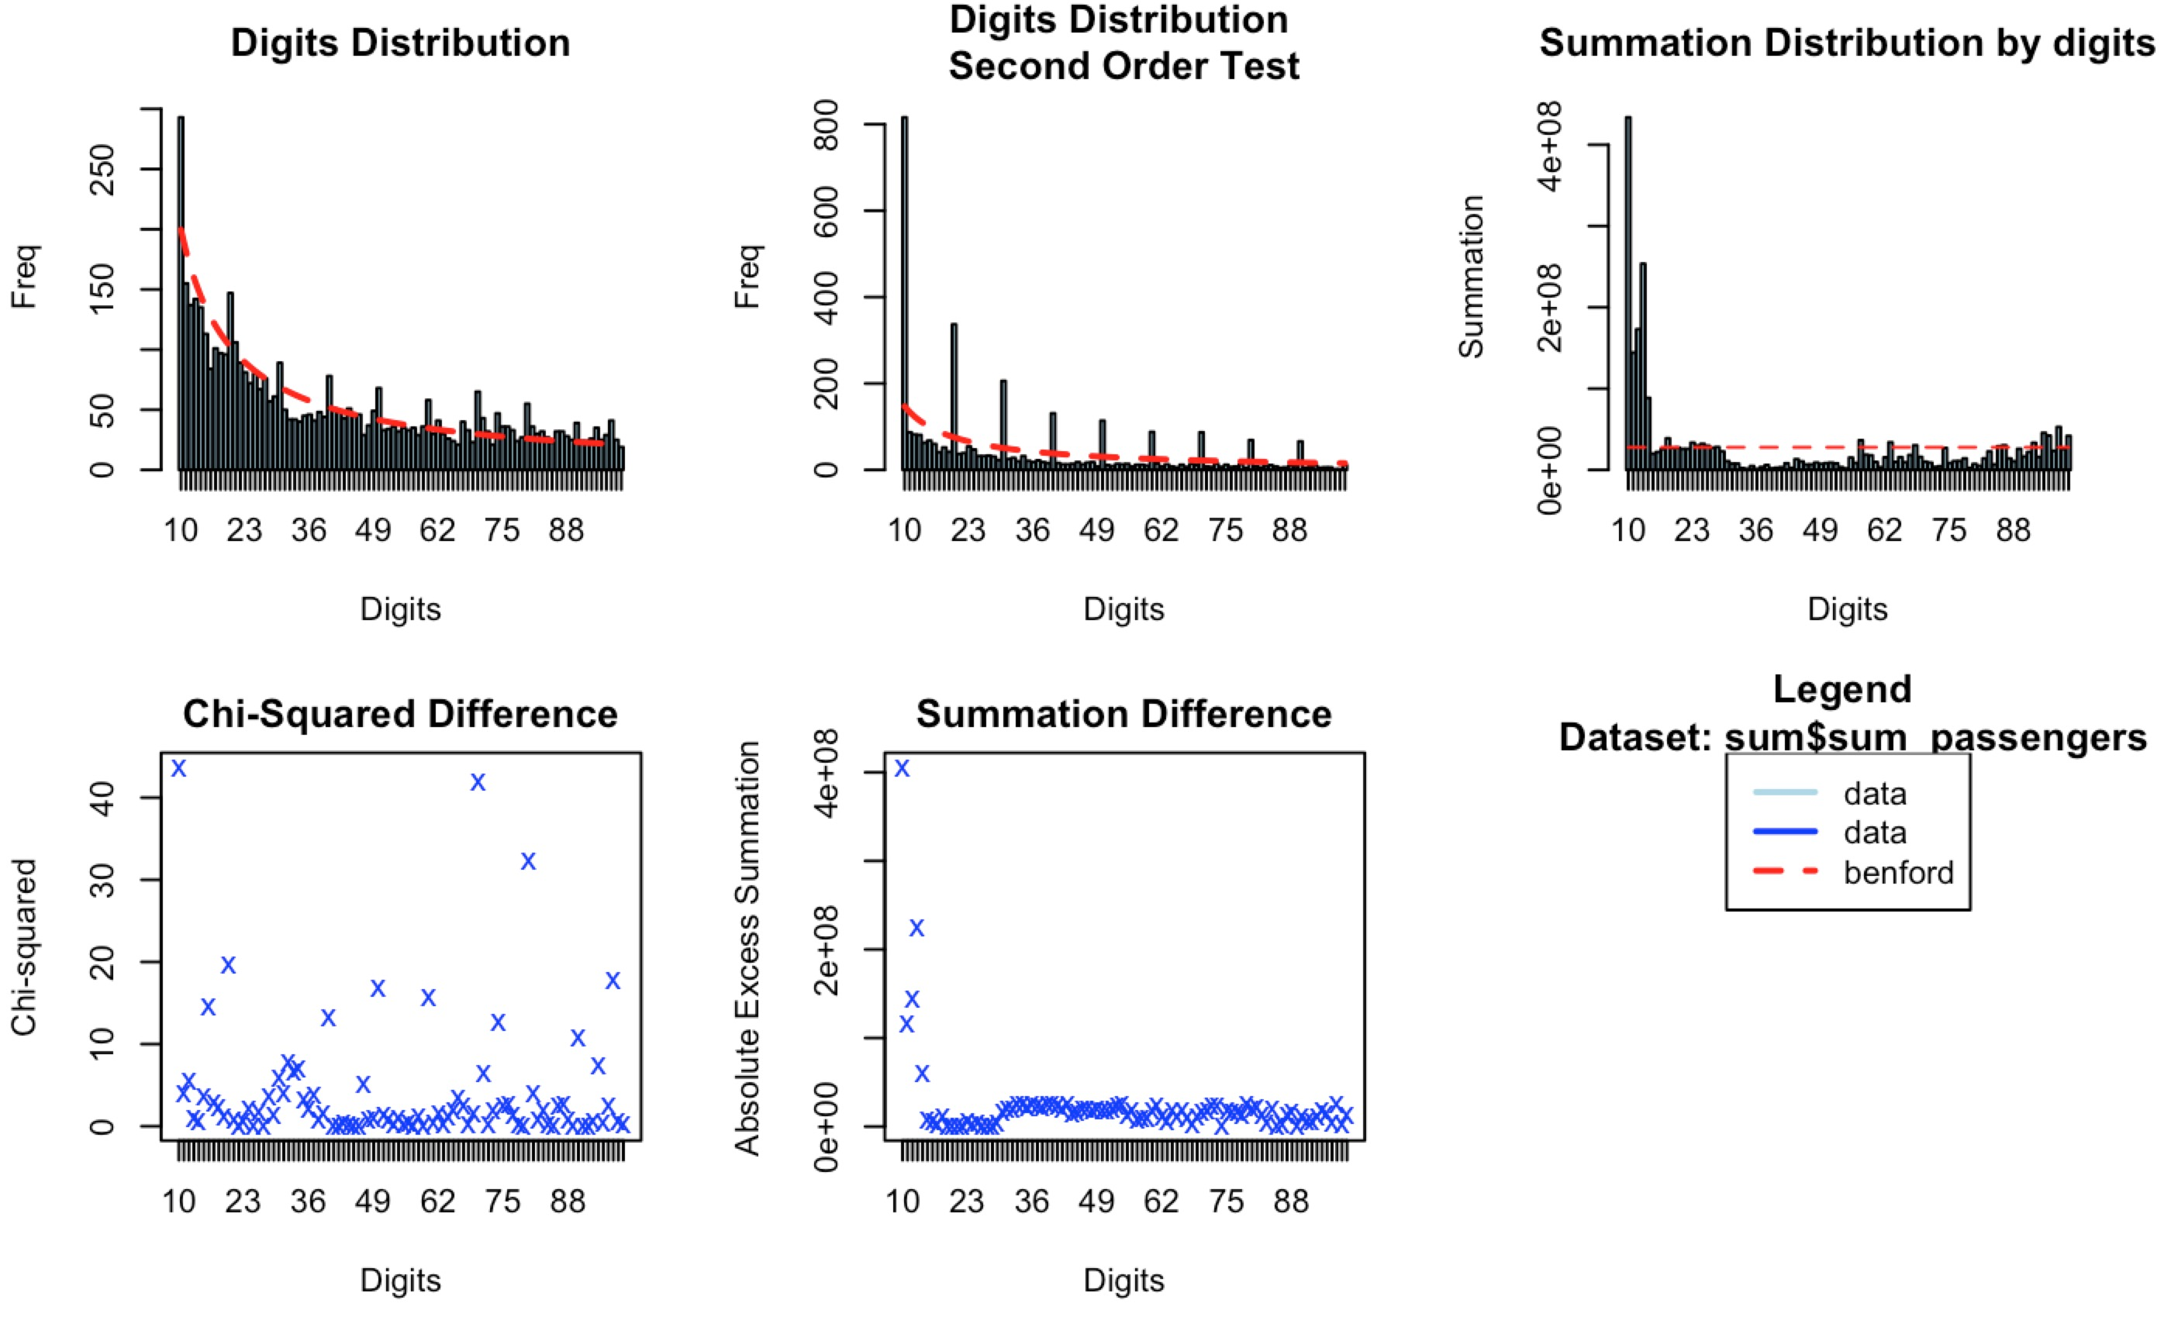
Let's look at what Benford's analysis?
1. Overall the data follows the distribution of Benford's law pretty well as we can see that the dashed red line matches with the black bar plot.
2. There are some spikes on different region especially on 1. This is probably due to the fact that our dataframe is only consisted of three years data.

Slide 5
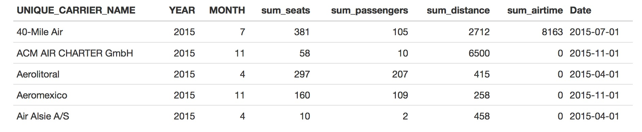
suspicious airlines using Benford analysis

Slide 6
suspicious airlines using Benford analysis
If you are careful enough, you will find out those suspicious airline companies have a 0 sum airtime but non zero entry for other columns! Wow. Benford's analysis find these suspicious data so quickly. We have some confidence to say that those airlines 'lie about' their air time. How does this happen? Probably because the data is not recorded in the system!

Slide 7
Thanks for watching
Any questions? Feel free to email me at lc18@bu.edu

